Slide 1
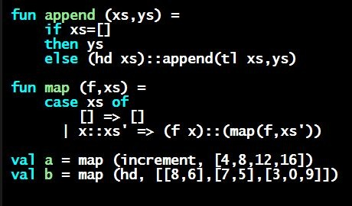
Programming Languages Dan Grossman
Another Closure Idiom: Combining Functions

Slide 2
More idioms
We know the rule for lexical scope and function closures
Now what is it good for
A partial but wide-ranging list:
Pass functions with private data to iterators: Done
Combine functions (e.g., composition)
Currying (multi-arg functions and partial application)
Callbacks (e.g., in reactive programming)
Implementing an ADT with a record of functions

Slide 3
Combine functions
Canonical example is function composition:
Creates a closure that “remembers” what f and g are bound to
Type ('b -> 'c) * ('a -> 'b) -> ('a -> 'c) but the REPL prints something equivalent
ML standard library provides this as infix operator o
Example (third version best):
fun compose (f,g) = fn x => f (g x)
fun sqrt_of_abs i = Math.sqrt(Real.fromInt(abs i))
fun sqrt_of_abs i = (Math.sqrt o Real.fromInt o abs) i
val sqrt_of_abs = Math.sqrt o Real.fromInt o abs

Slide 4
Left-to-right or right-to-left
val sqrt_of_abs = Math.sqrt o Real.fromInt o abs
As in math, function composition is “right to left”
“take absolute value, convert to real, and take square root”
“square root of the conversion to real of absolute value”
“Pipelines” of functions are common in functional programming and many programmers prefer left-to-right
Can define our own infix operator
This one is very popular (and predefined) in F#
infix |>
fun x |> f = f x
fun sqrt_of_abs i =
i |> abs |> Real.fromInt |> Math.sqrt

Slide 5
Another example
“Backup function”
As is often the case with higher-order functions, the types hint at what the function does
('a -> 'b option) * ('a -> 'b) -> 'a -> 'b
fun backup1 (f,g) =
fn x => case f x of
NONE => g x
| SOME y => y

